Slide 1
Introduction to Neural Networks
November 12, 2018
Dr. JAYABHADURI R
ASSOCIATE PROFESSOR
SVCE
ADITI PRAKASH
DATA SCIENCE INTERN
SCREEL LABS

Slide 2
AGENDA
Introduction to Neural Networks
Mathematics in Neural Networks
SECTION I
SECTION II
SECTION III
SECTION IV
Basics of Neural Networks
Implementation

Slide 3
What to expect out of this session?
Understand the major technology trends driving Deep Learning
Be able to build, train and apply fully connected deep neural networks
Understand the key parameters in a neural network's architecture

Slide 4
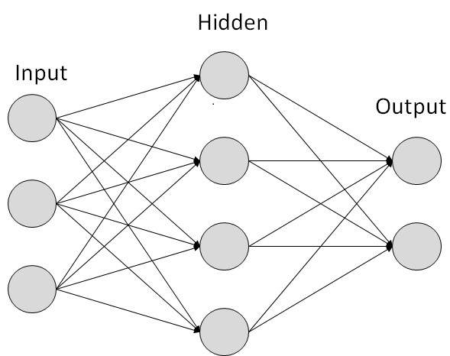
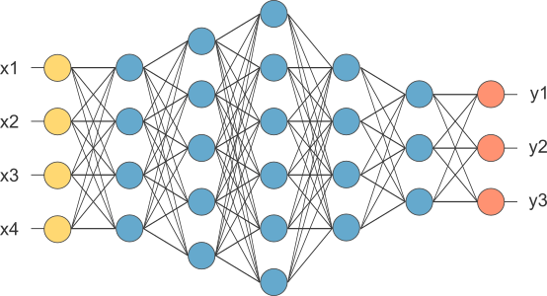
Neural Nets
4th grade
Advanced curriculum
18 students
SIMPLE NEURAL NETWORK DEEP NEURAL NETWORK

Slide 5
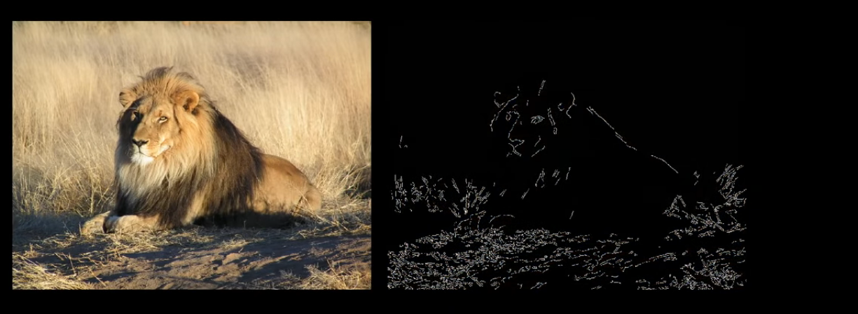
Layers
Neuron
An image is made of 28 x 28 pixels that make up 784 neurons in the first layer (input layer)
Holds a number between 0 and 1 which represents the grayscale value of a pixel in an image
0.8
0 represents Black and 1 represents white
This number is called “Activation” which gets lit up when its a high number
9
Patterns
Pixels
Edges
Images

Slide 6
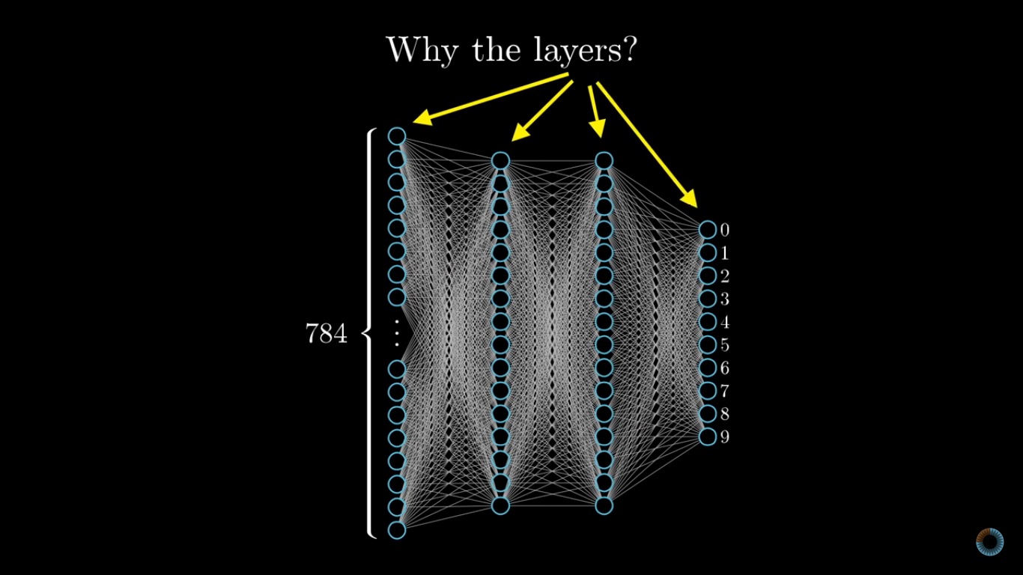
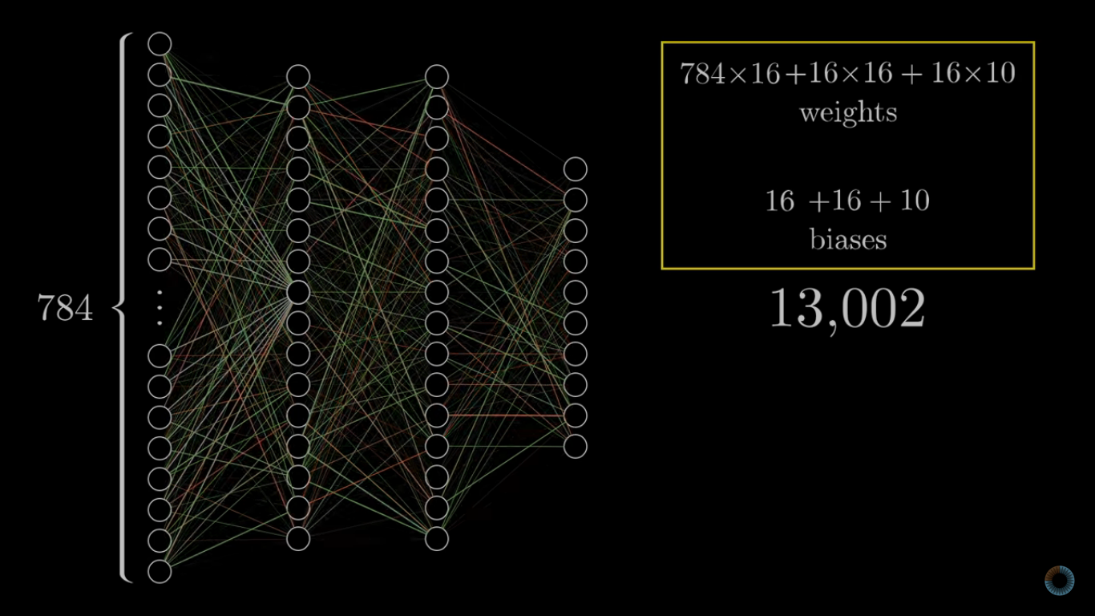

Slide 7
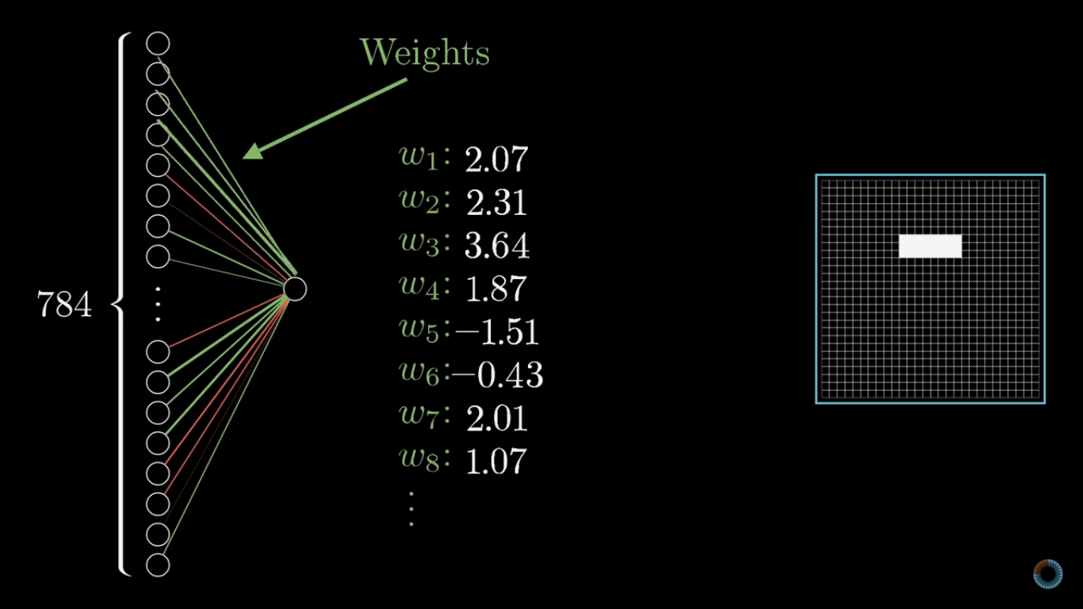
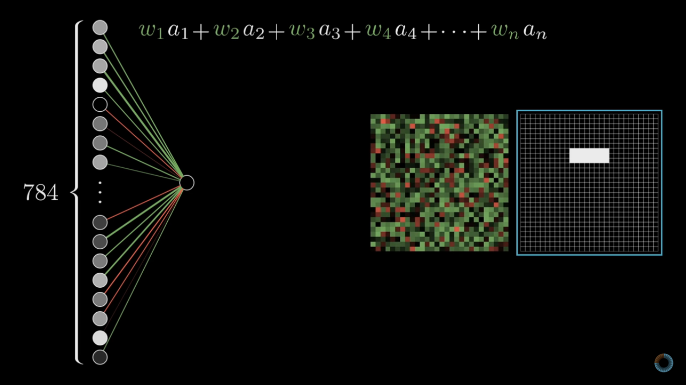
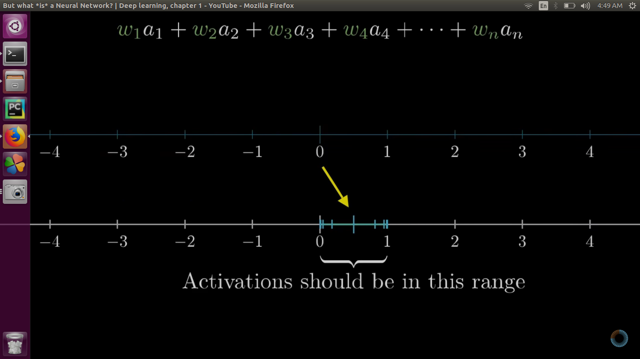
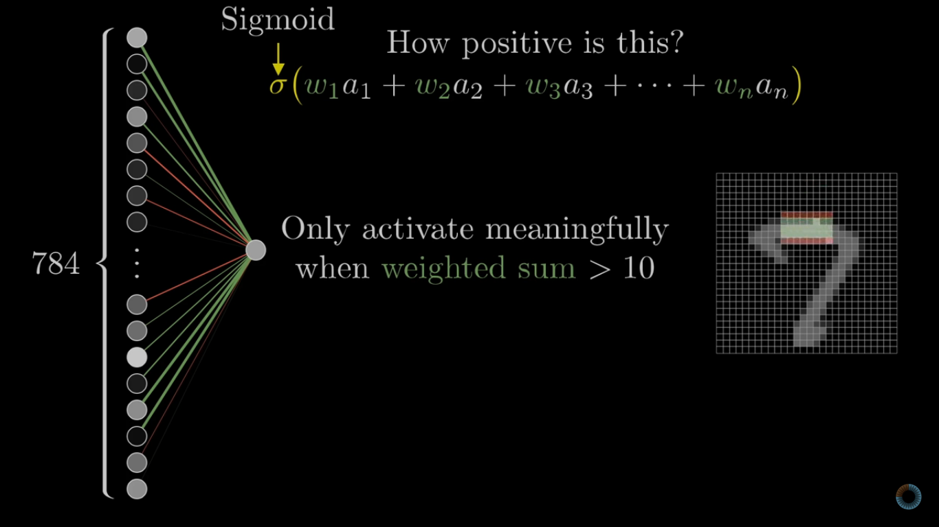

Slide 8
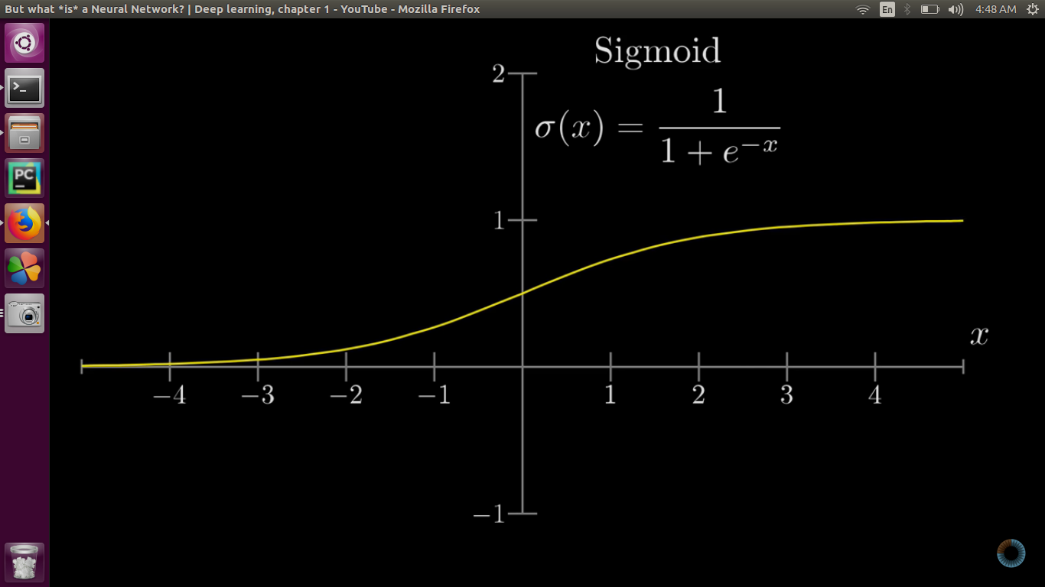
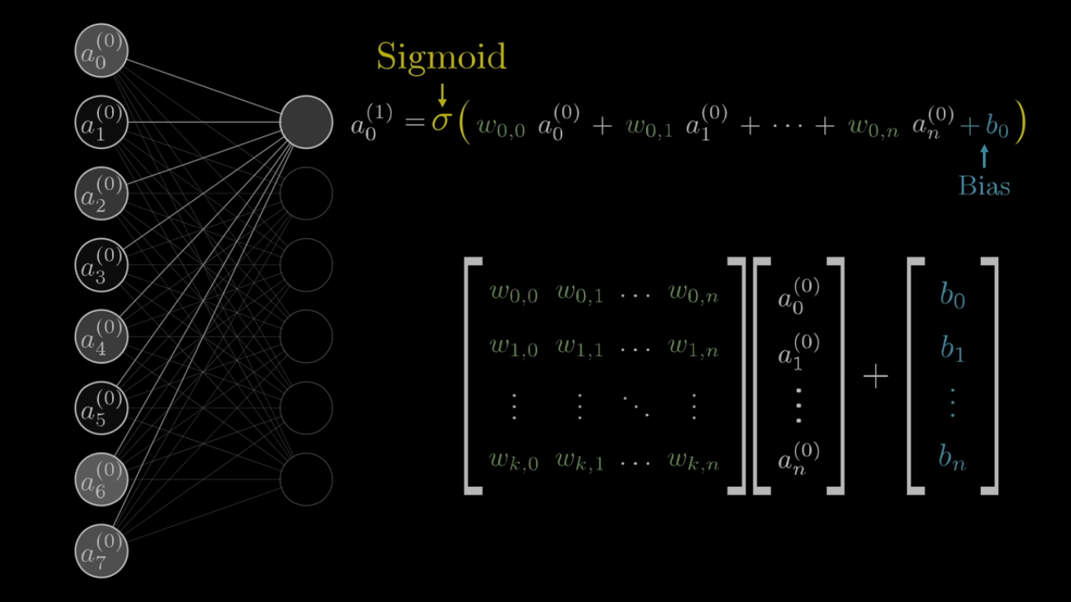

Slide 9
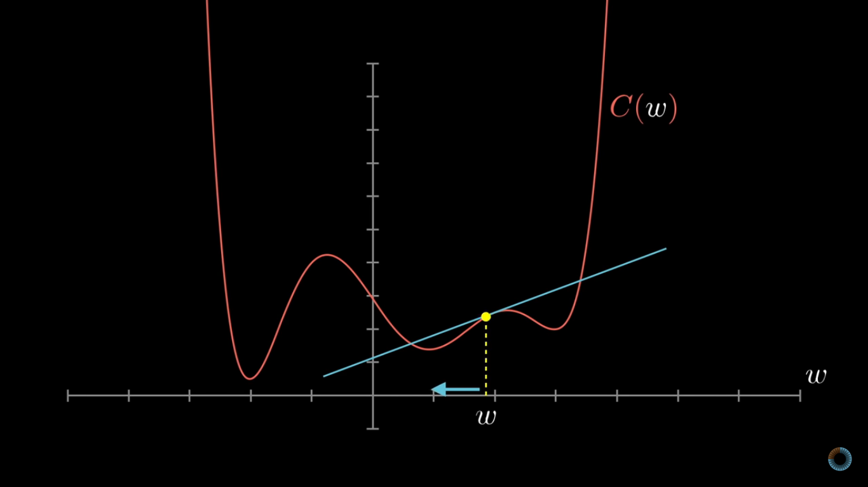
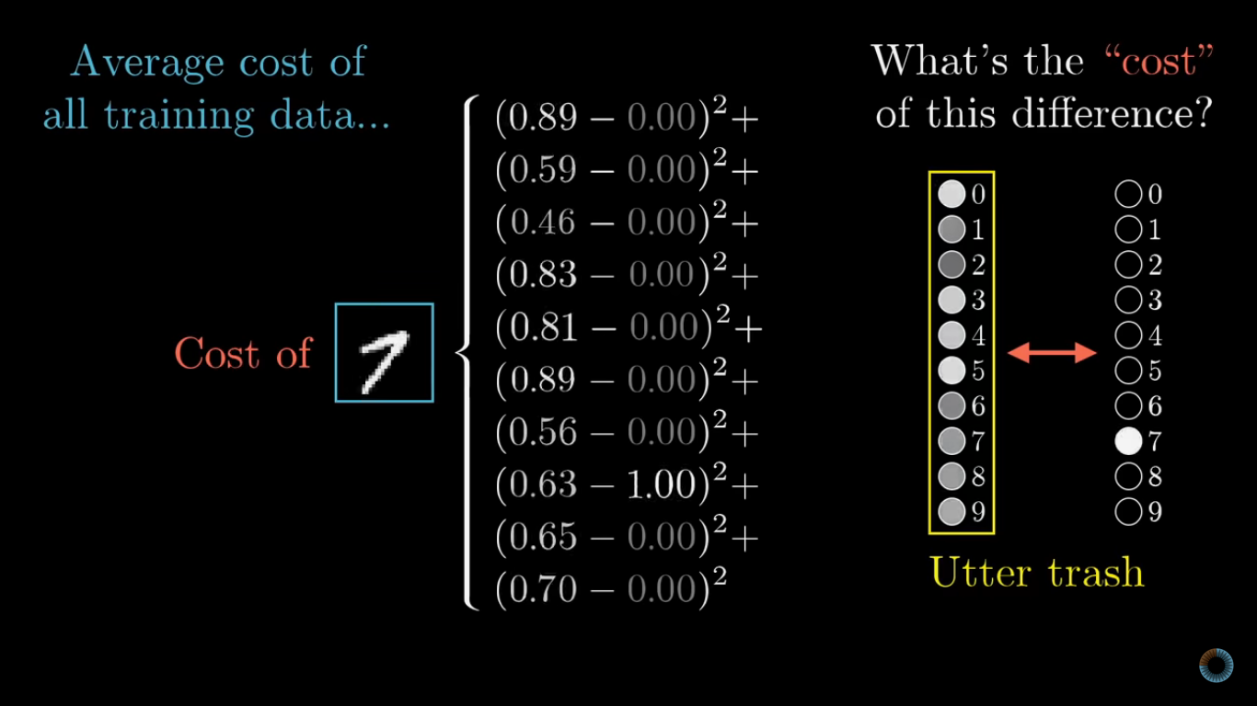
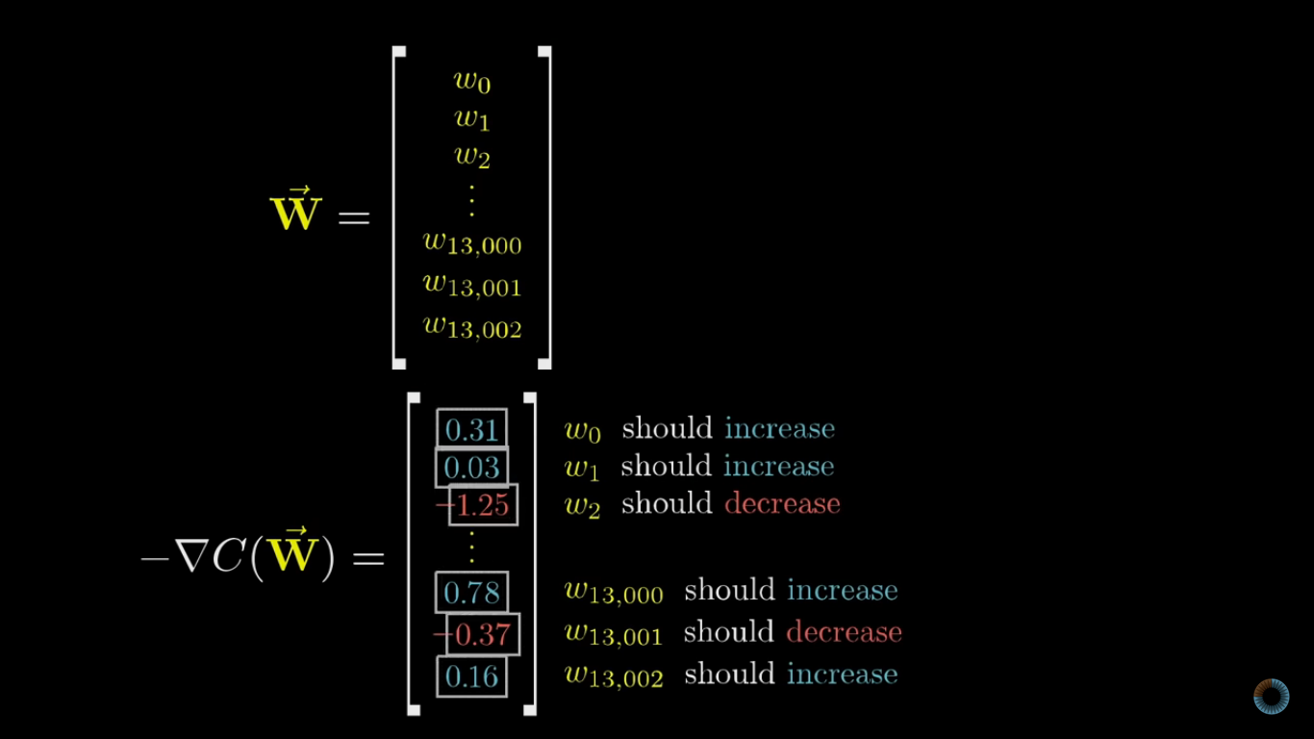
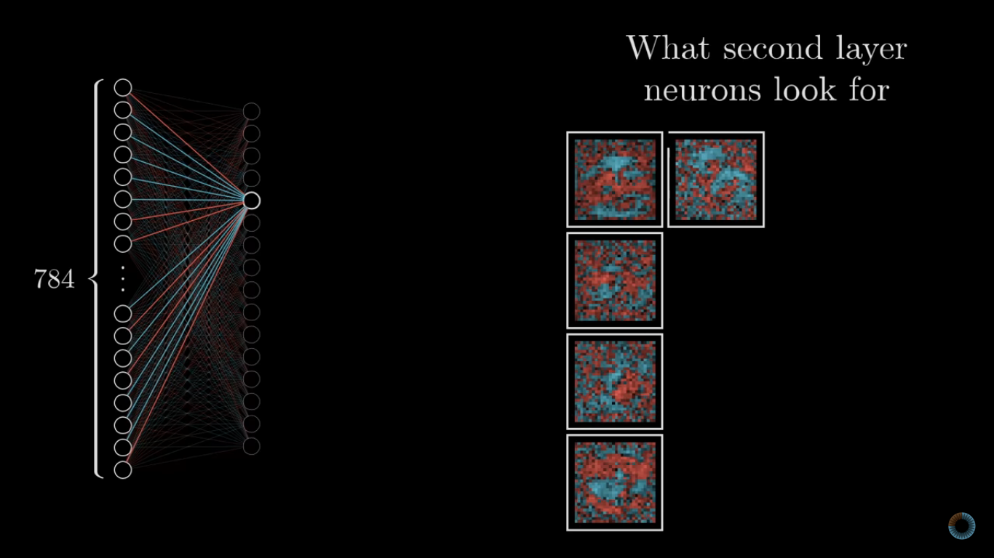

Slide 10
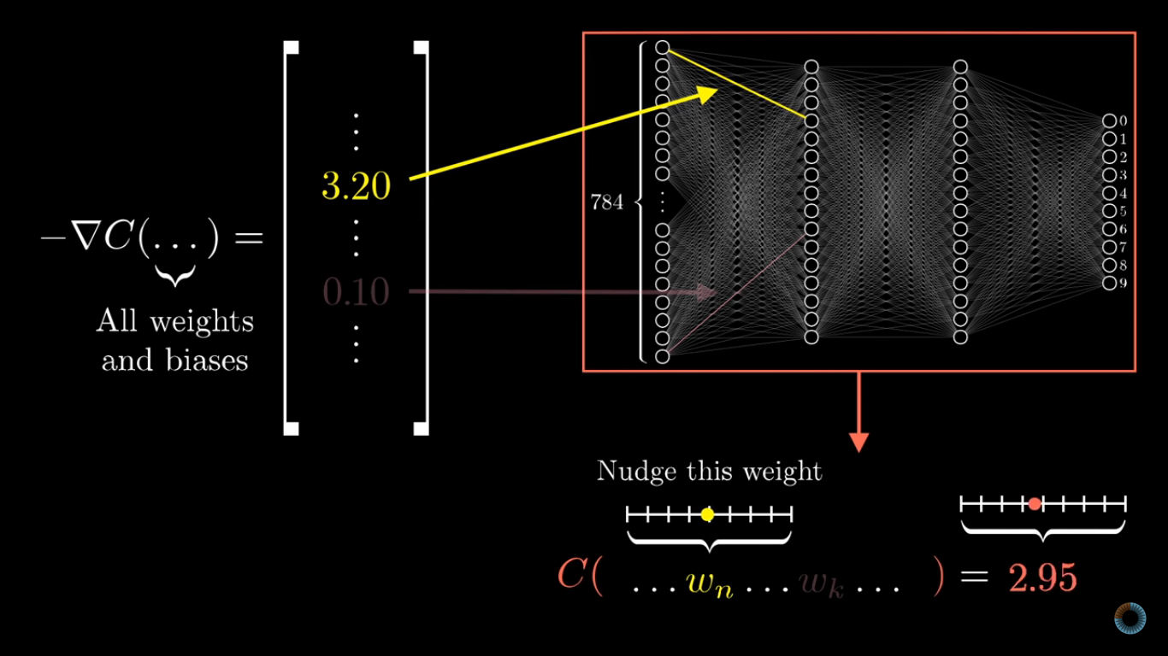
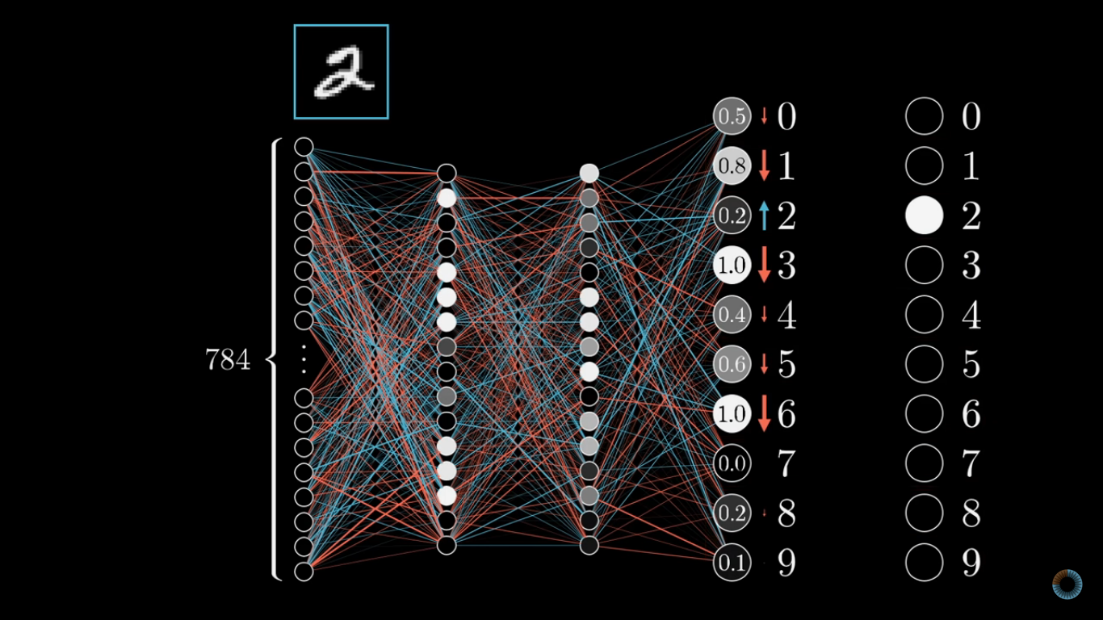
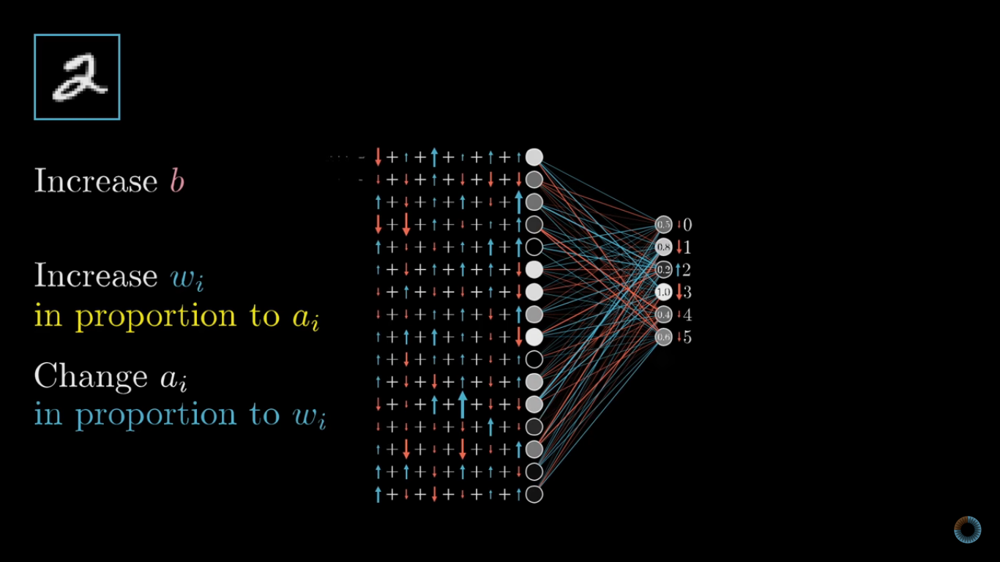

Slide 11
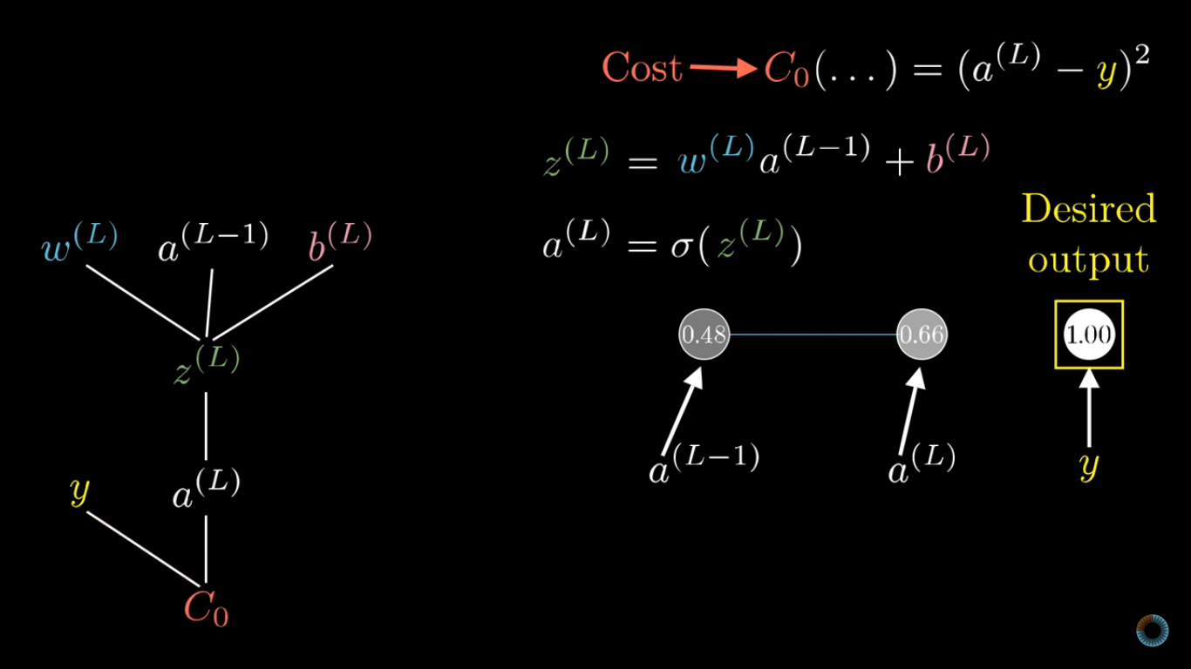
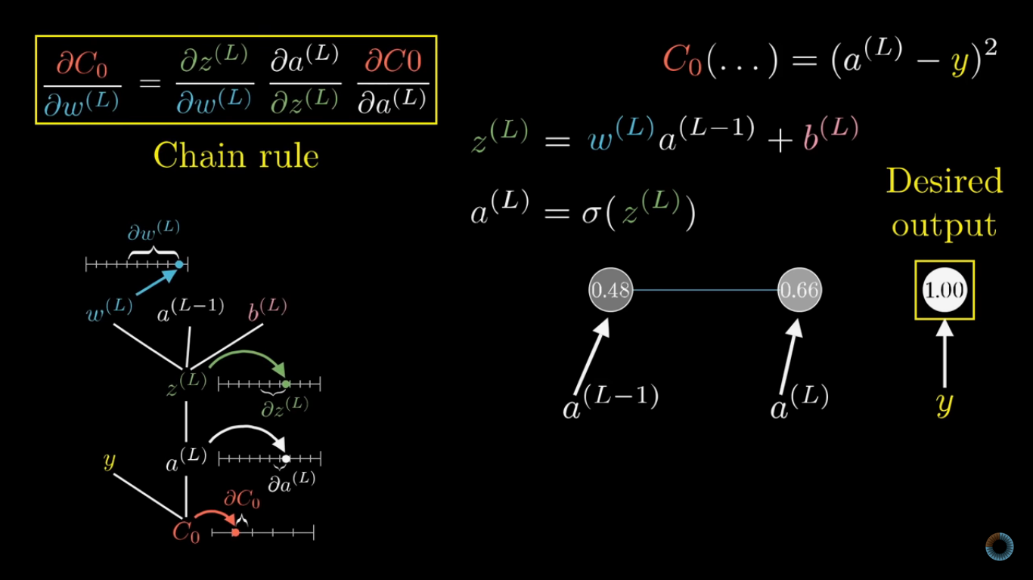
BACKPROPAGATION AND THE MATH BEHIND IT

Slide 12
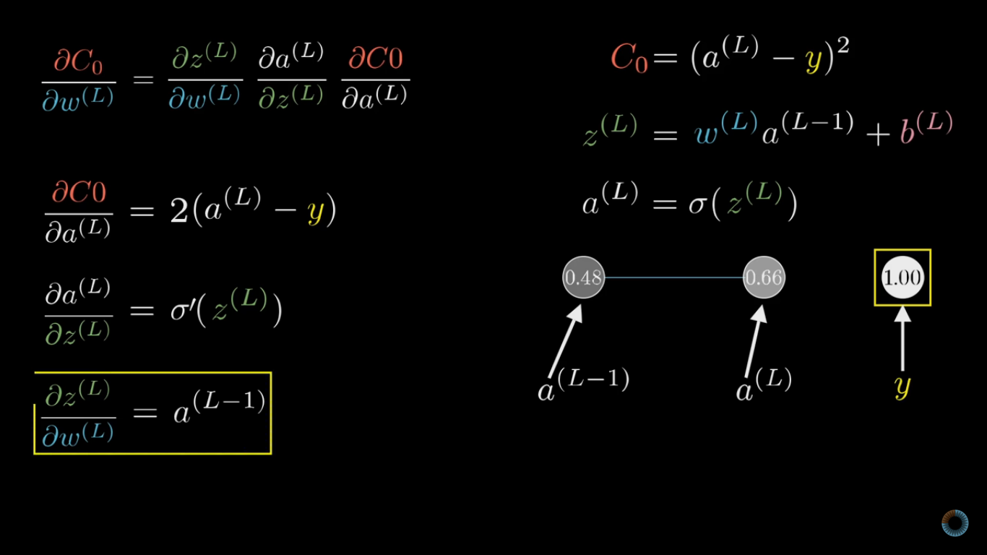
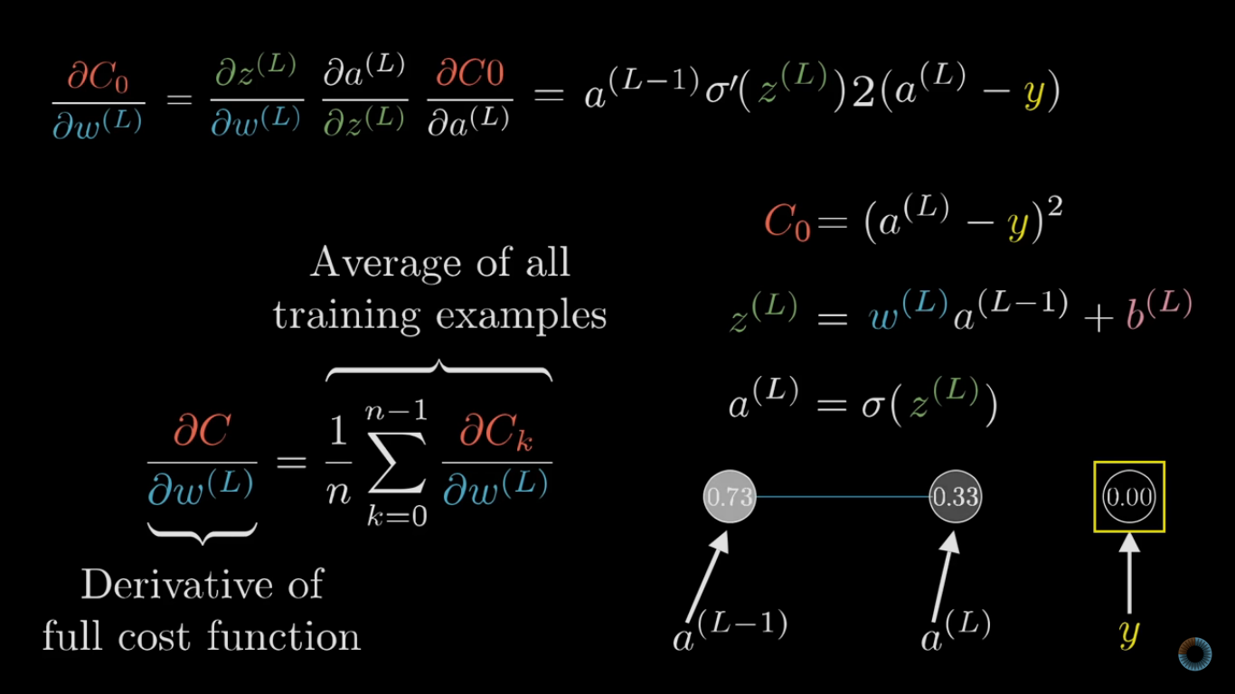
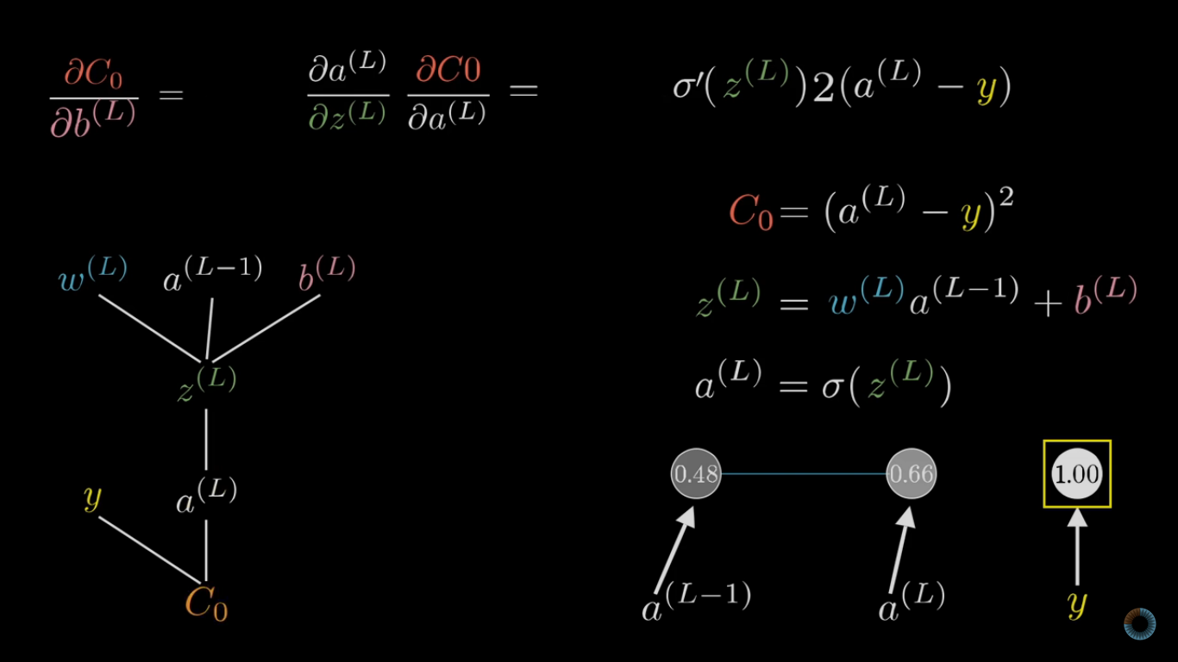
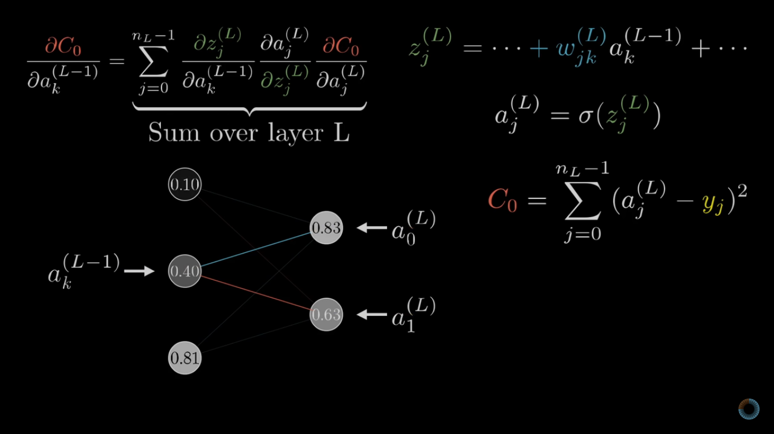

Slide 13
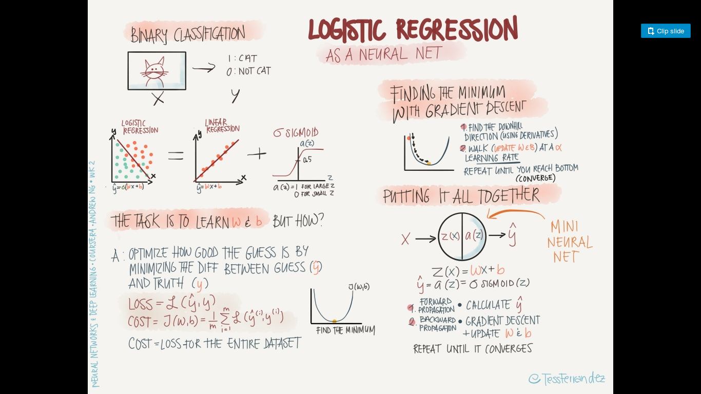

Slide 14
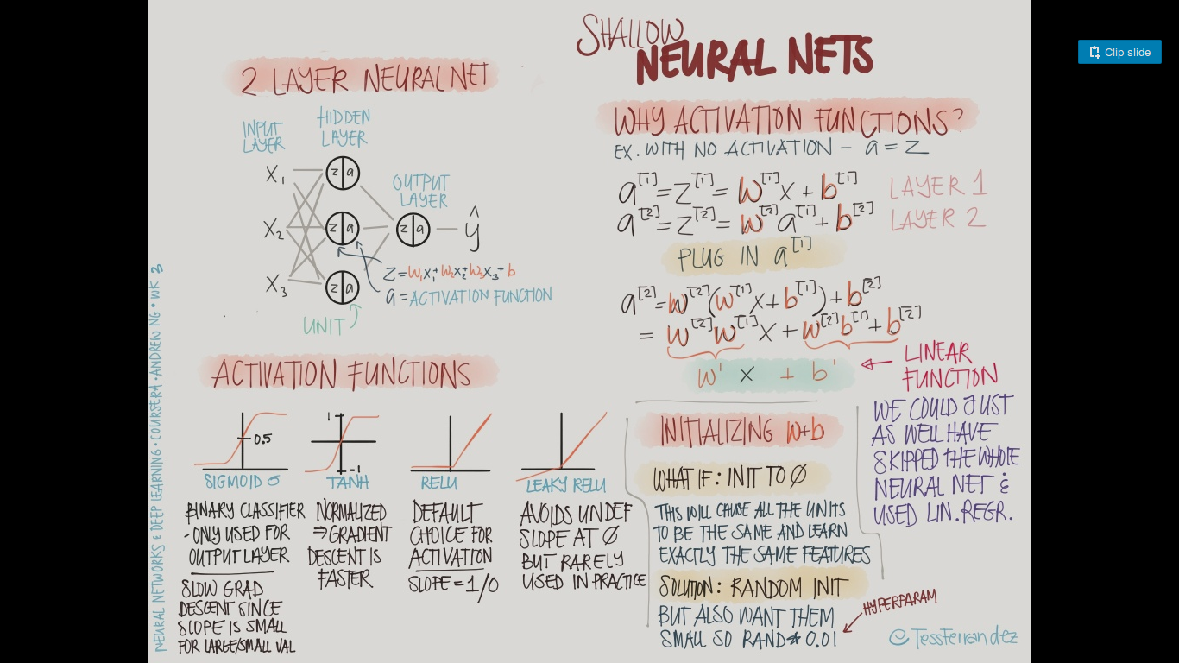

Slide 15
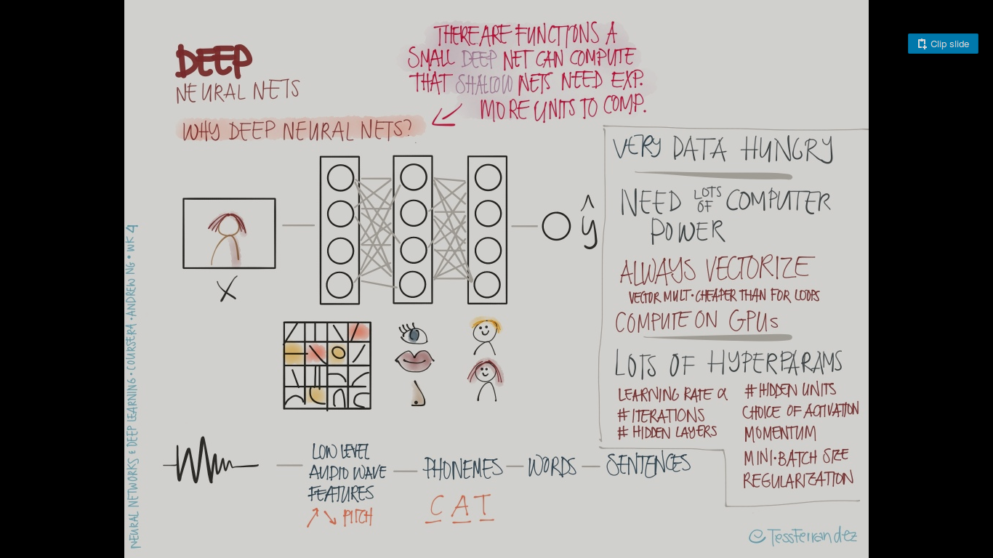

Slide 16
Implementation - numpy hints

